Slide 1
Department of CSE (dAta science)
Instagram Sentiment Analysis
Presentation By:
N Vishnu Vardhan (21211A6742)
V Koushik Krishna (21211A6762)
Saahithi Reddy Patel (21211A6754)
S Anushravya (21211A6757)

Slide 2
Project Introduction
The primary objective of our project is to analyze the sentiment of Instagram posts to gain insights into public feelings, attitudes, and opinions.
This sentimental analysis is done in three levels where in which their comment can be in either POSITIVE, NEGATIVE or NEUTRAL.
Key Components:-
Extracting key insights to comprehensively understand public sentiment towards specific events, products, or topics.
The project is based on machine learning approach using a pre-trained Naïve Bayes classifier by Text Blob library
Helps to track the sentiment and facilitating better planning and execution for future endeavors.

Slide 3
Data set details
Procuring the data via web scraping methods.
Data is collected from Instagram using ‘Instaloader’ library.
Extracting the relevant data such as comments and associated metadata for analytical purposes only when the account is in public but not in private.
Forming a CSV file and applying sentiment for the extracted data.
It contains columns like :
Post_shortcode
Commenter_username
Comment_text
Comment_likes

Slide 4
Algorithm used
The specific algorithm is used in this sentimental analysis is Naive Bayes classifier TextBlob library.
In it we used to compute the polarity of the comment text.
TextBlob is provides a simple and easy of use for nlp tasks.
This TextBlob is specially deals with smaller datasets and also with the real-time analysis.
When we use the “TextBlob(text).sentiment.polarity” it computes the polarity of the text using this underlying classifier
The project is combined with web scraping with sentimental analysis for the comments of the respective Instagram post.

Slide 5
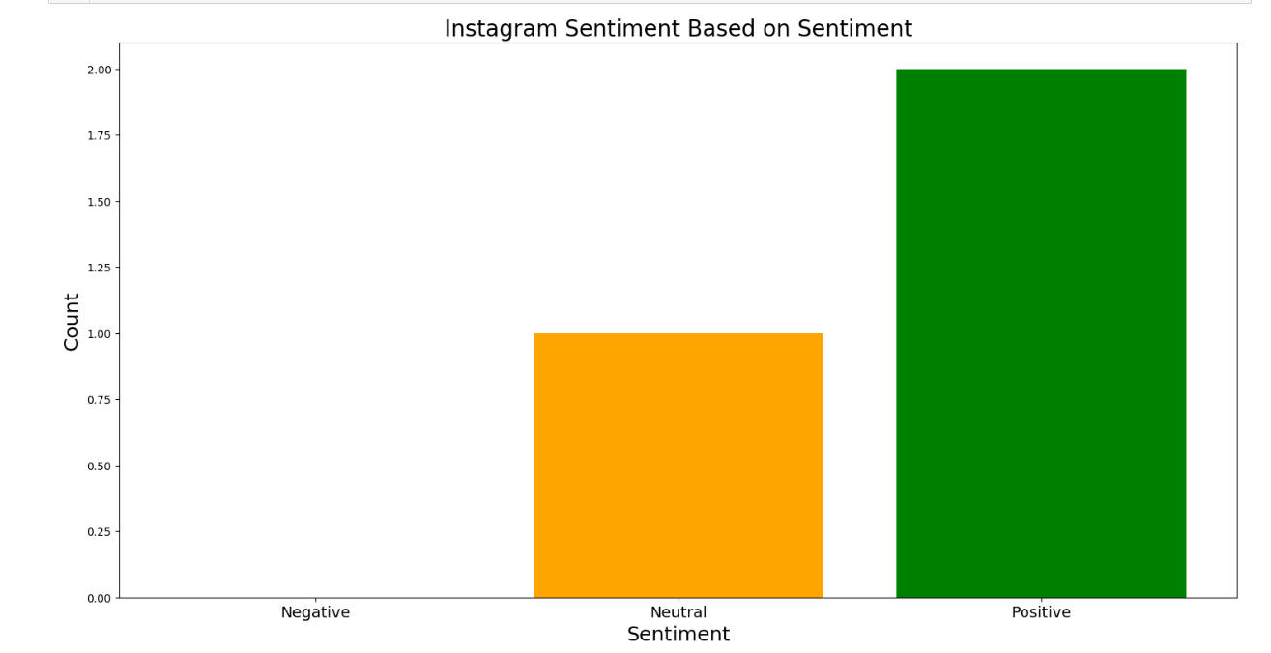
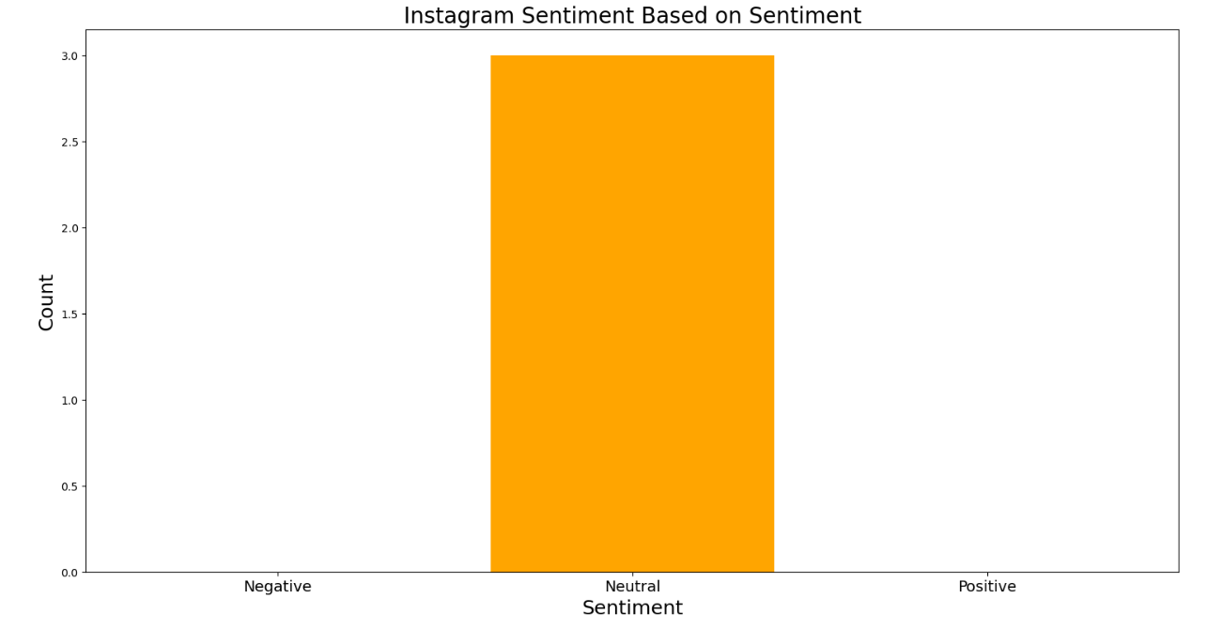
Result analysis

Slide 6
Application of the project
Brand Monitoring :- Analyse comments and feedbacks on brand campaigns or product launches to assess their impact and reaction
Trend Identification :- Analyse sentiments over time to time to identify the shifts in public opinion
Social Media Planning :- Analyse the results and changing the feed of the user and how they engage with the content and create resonant posts
Moderation :- Analyse to identify and filter out the potentially harmful and inappropriate content.
Competitive Analysis :- Companies use this Instagram sentimental analysis to monitor and analyse the sentiment related their competitors.

